Slide 1
The Book Exchange
By Group 5:
Dylan Huang, Thomas Ogden, Cindy Huang, Alexander Ramirez, Isaiah Villalobos, Aaran Li

Slide 2
Project Overview
The purpose of the Book Exchange Web Application is for users to post books, search and browse a catalog, favorite books for later reference, and add comments to book listings. Users can also manage their shopping cart, view and delete their own posted books, and access detailed book information. The site features an intuitive design with clear navigation for a seamless user experience.

Slide 3
Project Specifications
Team Management Tools
Development Tools and Frameworks
Discord
Google Docs
Google Slides
Django 5.1
PostgreSQL
Anaconda
Python
Pycharm
HTML 5
CSS
Bootstrap 5.3

Slide 4
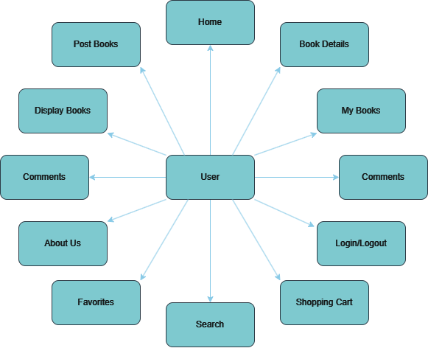
Project
Architecture

Slide 5
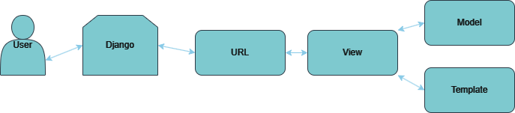
Model-View Template (MVT) Structure

Slide 6
Project Functions
Home
My Books
Shopping Cart
Login/Logout
Book Details
Search
Register User
About Us
Display Books
Comments
Post Books
Favorites

Slide 7
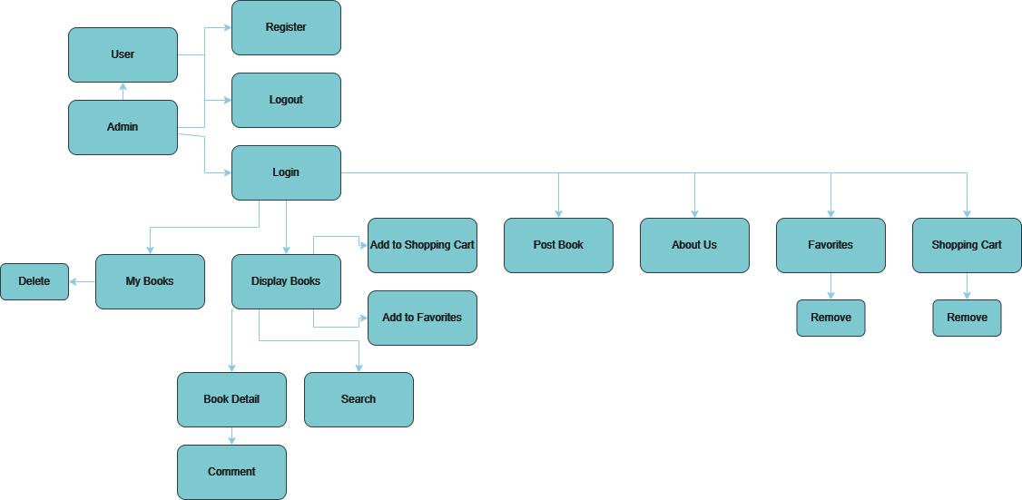
Project Overall System

Slide 8
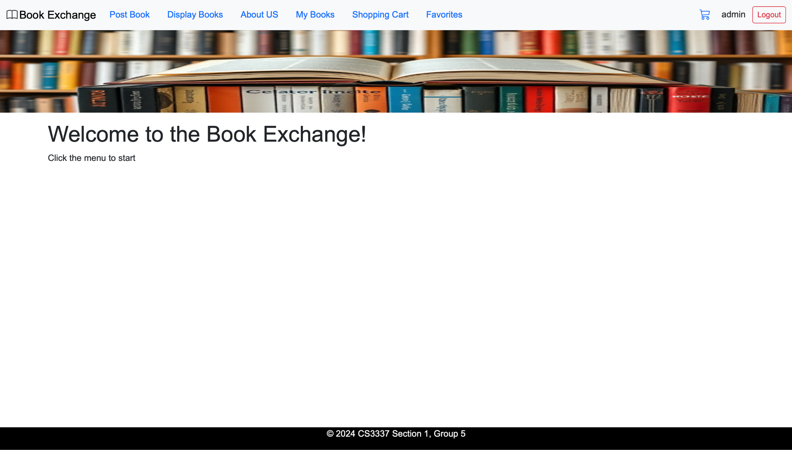
01
Home Page
On the right you will see our home page. This is the first page a user will see.
At the top, users have access to the navbar with options to post a book, view my books, displayed books, about us, their shopping cart, their favorites, their username and an option to log out.
However, users MUST be logged in to access books they’ve uploaded and favorites.

Slide 9
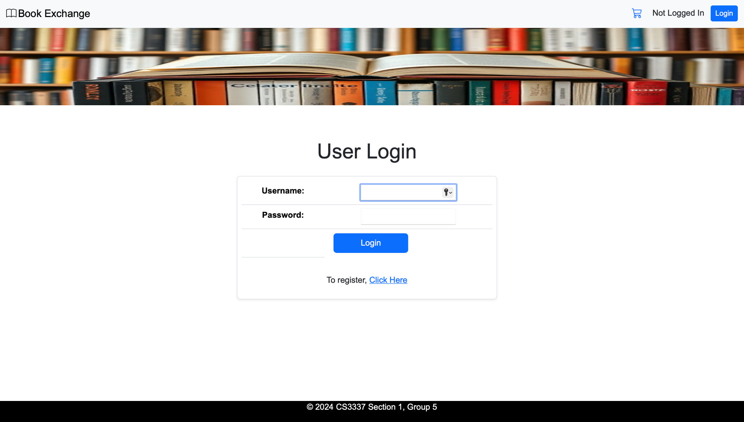
02
Login
If a user is not logged, they can access the user login by clicking the “Login” button on the navbar.
After logging in successfully, users have access to all the features of the website.
If a user is not logged in and tries to access their books or favorites they will be redirected to the user login.
Users can log out by clicking the “Logout” button on the nav bar.

Slide 10
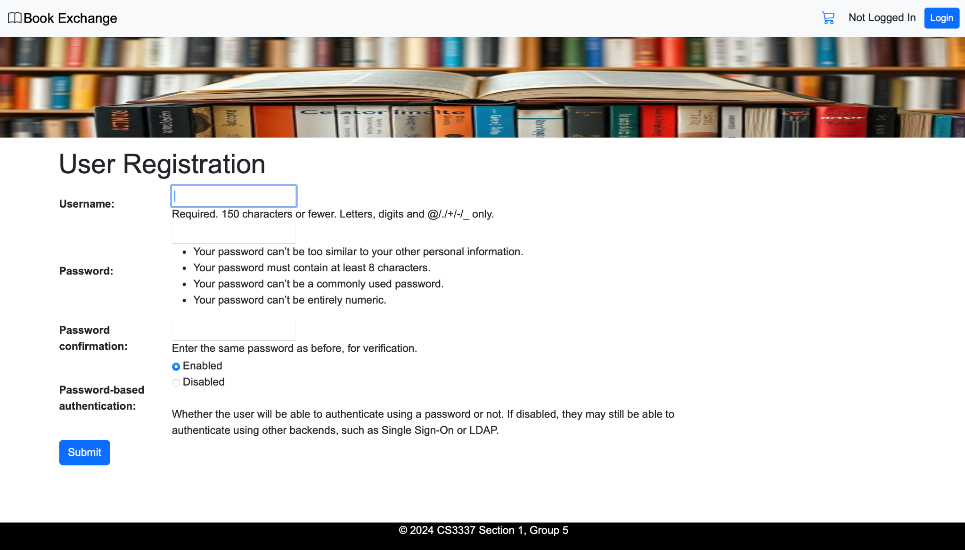
03
Register
Unauthorized users can register for a new account after clicking the “Login” button. It takes the user to the login portal where they can then register after selecting the “Click Here” link.
After registration, users will gain access to all the website’s features including the “My Books” page and their “Favorites” list.

Slide 11
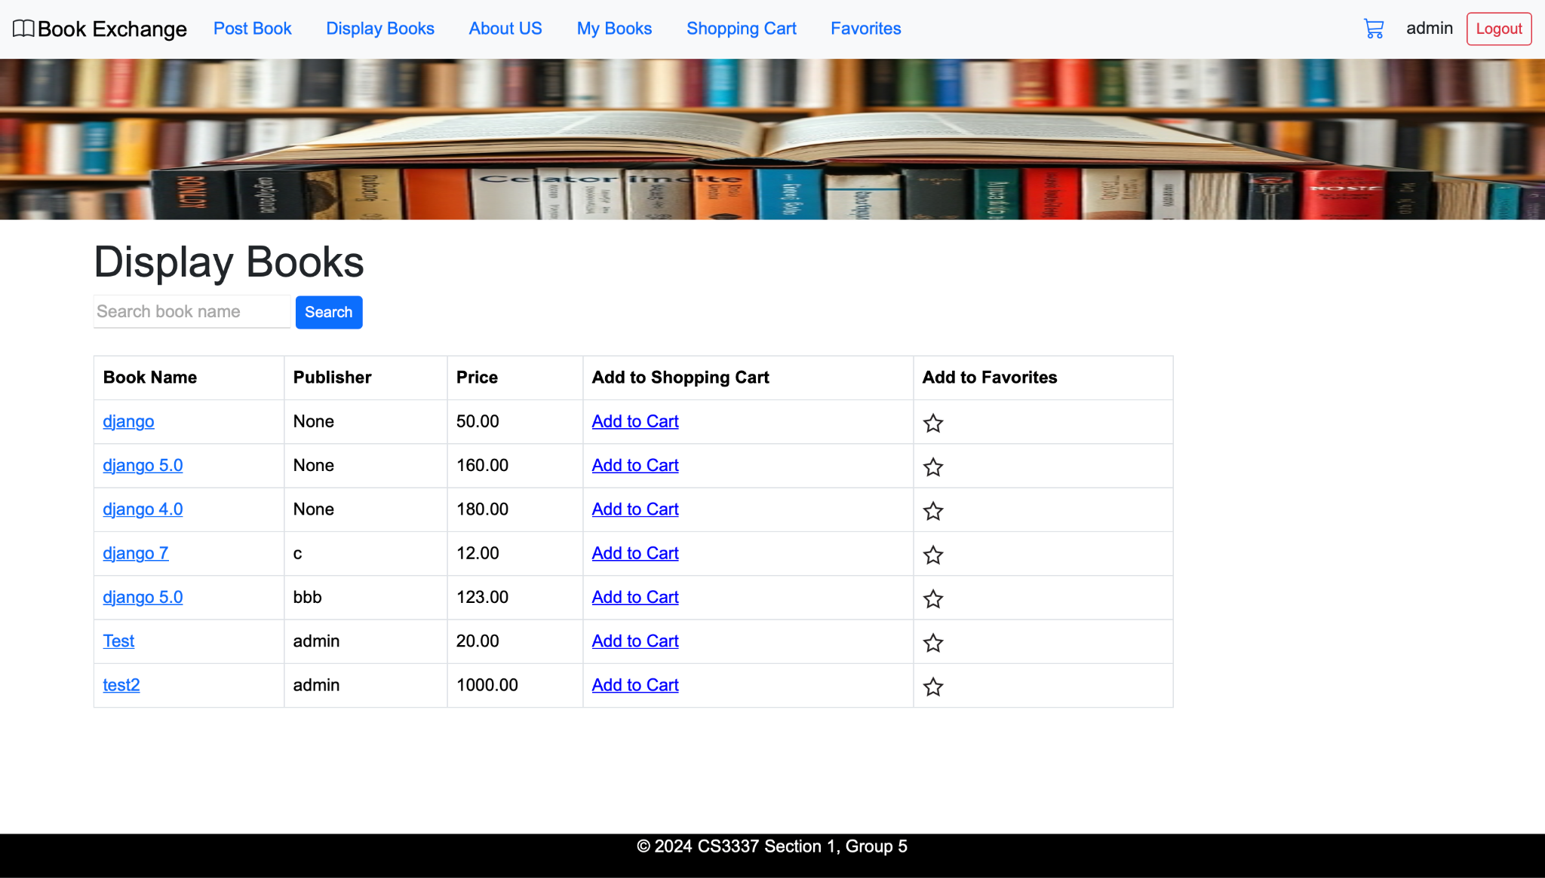
04
Display Books
Any user has access to all published books.
By clicking Display Books on the nav bar, a user is redirected to the display books page.
On the page, they will see a table with all books including the book’s name, the publisher, the option to add the book to the shopping cart and the option to add the book to the favorites.
Users also have access to the search functionality where a user can search for a book by name or by publisher.

Slide 12
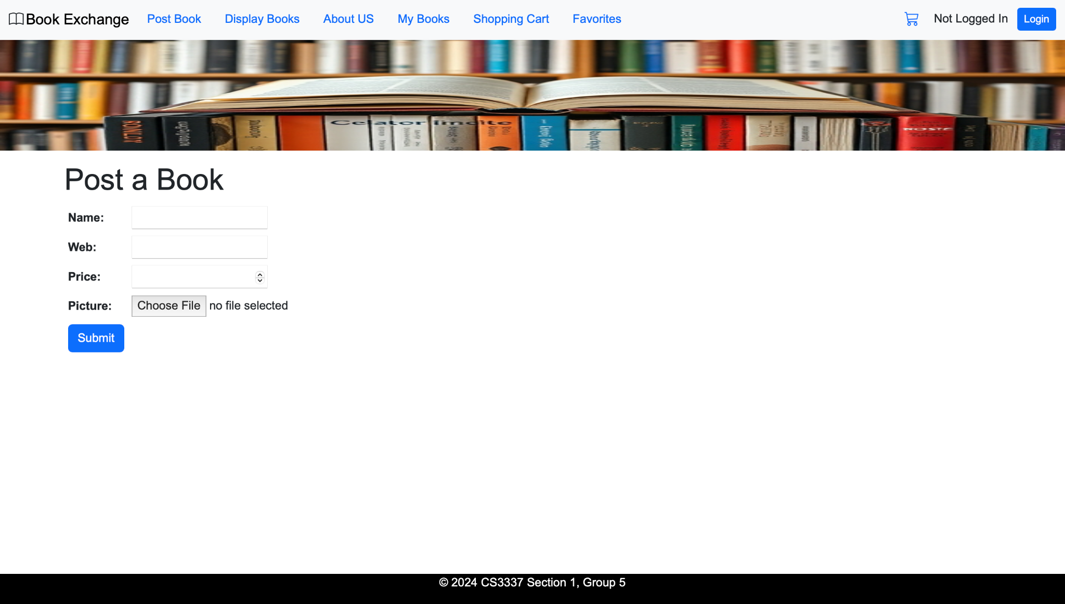
05
Post Books
Any user has access to publish their books.
By clicking Post Book on the nav bar, a user is redirected to the post book page.
On the page they will be prompted to give the book’s name, the website, the price and its picture where then they can then submit.
A submitted book will appear in the Display Books page with the user who posted it.

Slide 13
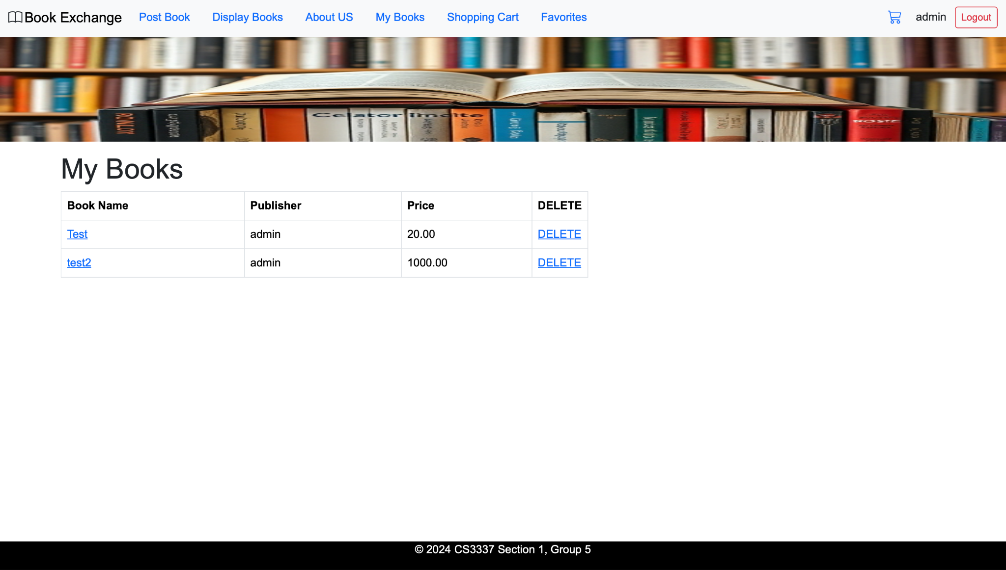
06
My Books
A logged in user has access to the books they have published.
By clicking My Books on the nav bar, a user is redirected to the my books page.
On the page they can view any books they have published and are able to delete them or view more information about them.

Slide 14
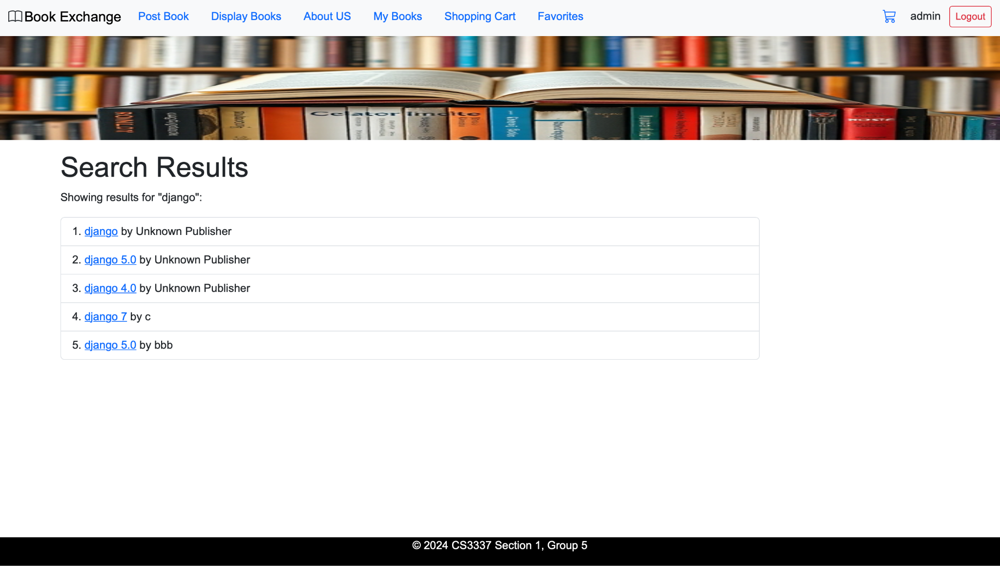
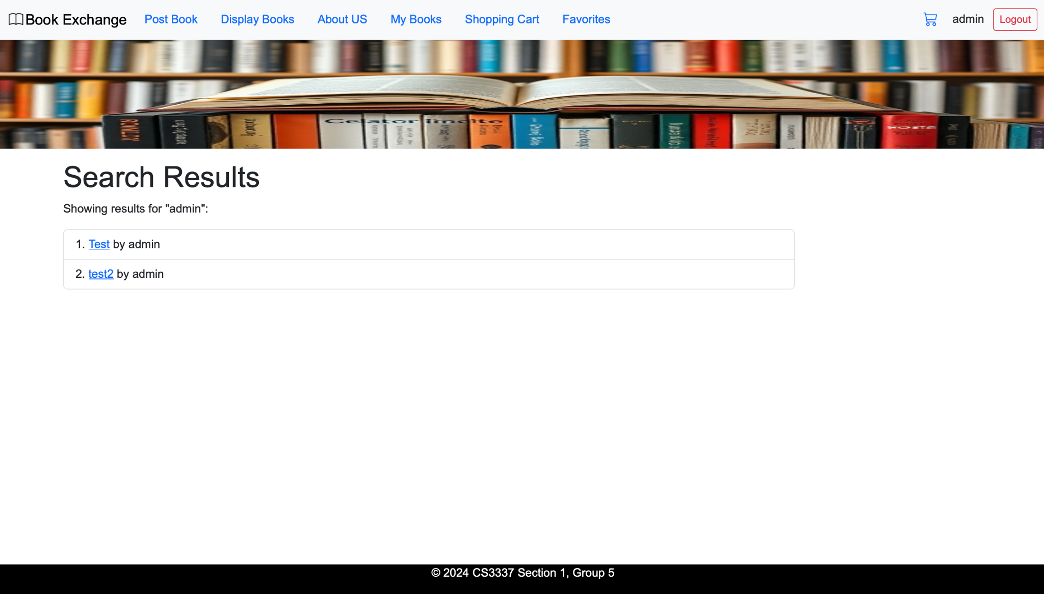
07
Search
In the display books page, users have access to the search functionality where a user can search for a book by name or by publisher.

Slide 15
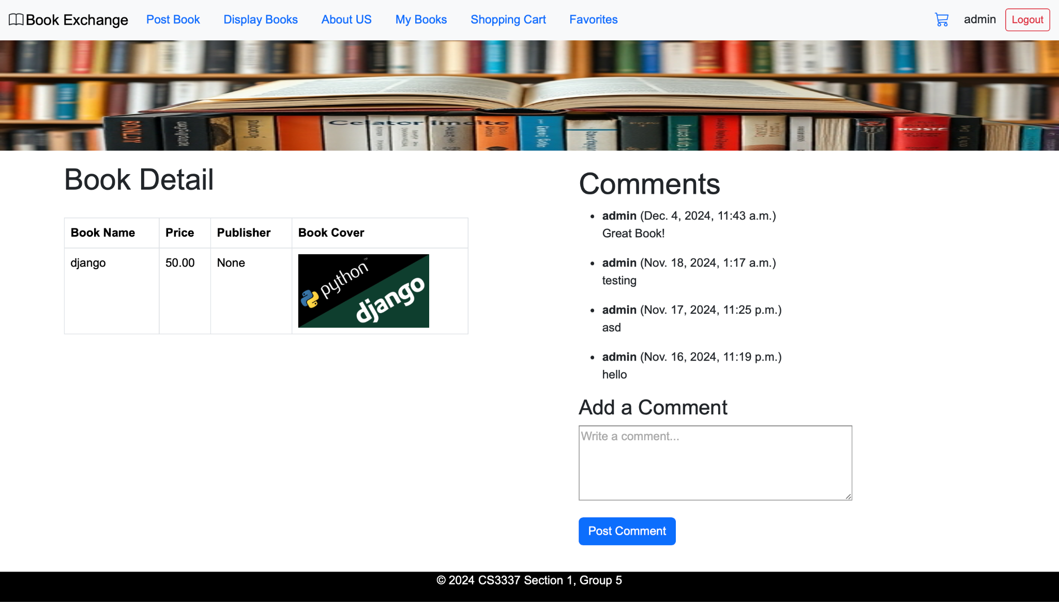
08
Comments
In the book detail page, logged in users have the ability to add comments to any books.
All users have access to any comments made and the date the comment was posted.

Slide 16
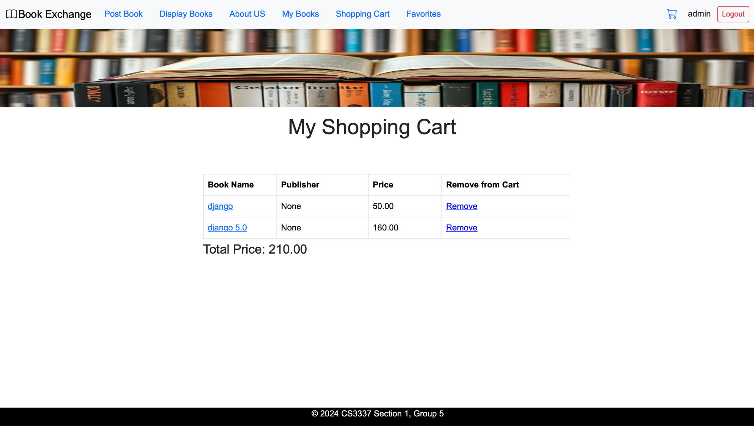
09
Shopping Cart
Users have the ability to add books to their shopping cart from the display books page.
Users then can access their shopping cart by clicking shopping cart on the nav bar.
They are then redirected to their shopping cart where they can see the books in their shopping cart.
Users can also remove books from their cart and see the total price of all books in their shopping cart.

Slide 17
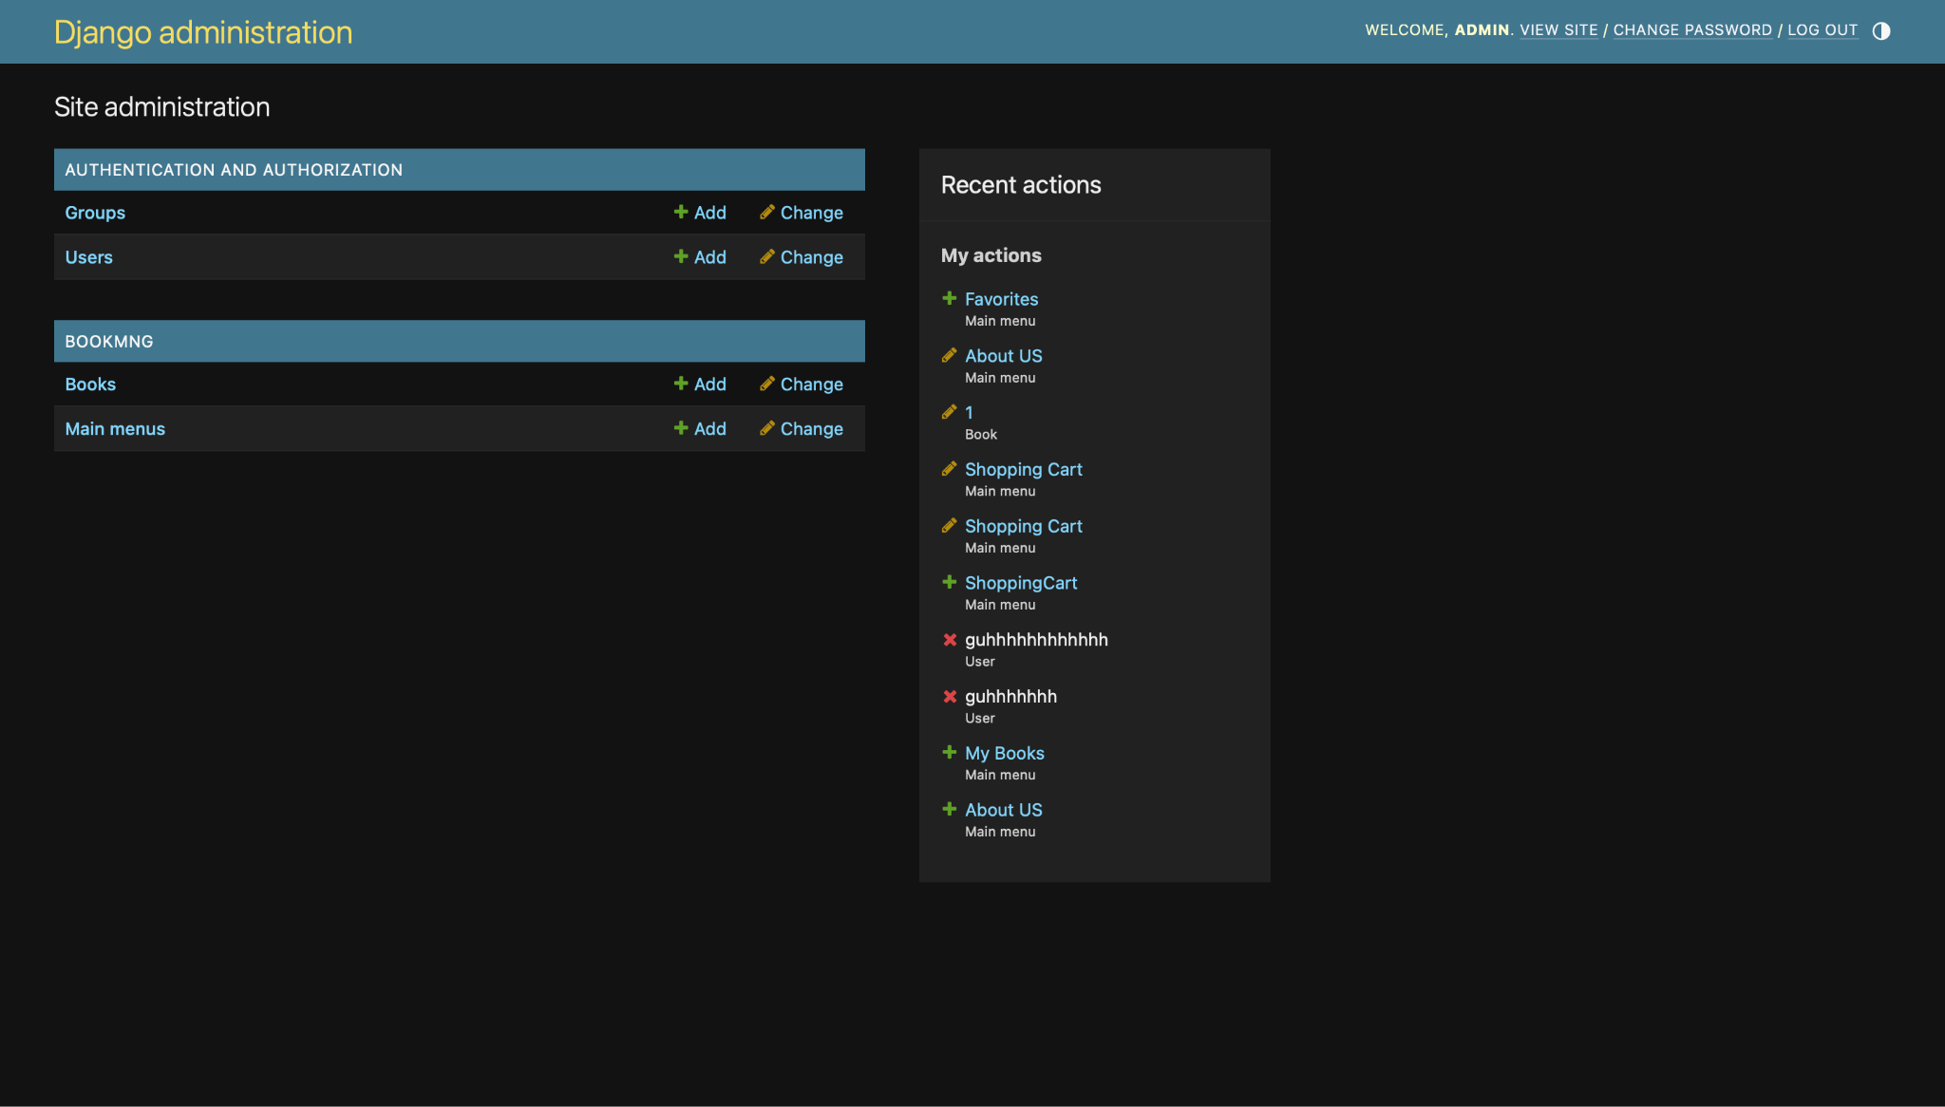
10
Admin
Django Admin page has every web page saved in it.
Allows for the management of all users, books and comments.
Allows for developers to add new menu items into the nav bar.
Reads metadata from models for a quick interface for the users to use the website.

Slide 18
Thank you!

